Slide 1


Arduino Joystick Control: LED & Buzzer
Join us as we delve into a beginner-friendly Arduino project that leverages the power of joysticks to control LEDs and buzzers.
by Shashwat Singh

Slide 2
Project Overview
Objective
Benefits
Control an LED's brightness and a buzzer's sound frequency using the joystick's X and Y axes.
Learn how to read analog inputs, manipulate outputs, and create interactive projects with Arduino.

Slide 3
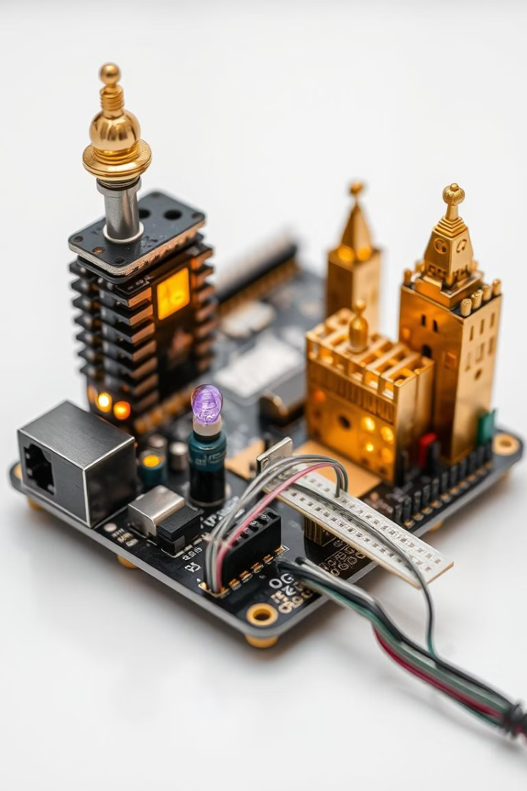
Essential Components
Arduino Uno
Joystick Module
The microcontroller brain of our project. It processes the joystick's signals and controls the LED and buzzer.
A versatile input device with two analog axes (X and Y) and a push-button switch. It translates your movements into electrical signals.
LED, Resistor, and Buzzer
Breadboard and Jumper Wires
The output devices we'll be controlling. The LED provides visual feedback, while the buzzer generates sound.
The platform for connecting all components and forming our interactive circuit.

Slide 4




Connecting the Joystick
VRx to Analog Pin A0
VRy to Analog Pin A1
SW to Digital Pin 2
Connect the joystick's horizontal axis (VRx) to the Arduino's analog input pin A0.
Connect the joystick's vertical axis (VRy) to the Arduino's analog input pin A1.
Connect the joystick's switch (SW) to the Arduino's digital pin 2.

Slide 5
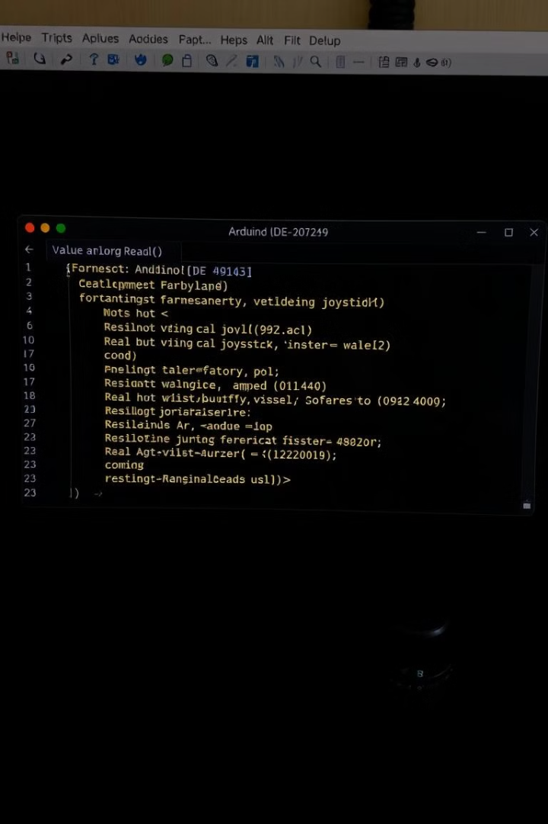
Reading Analog Inputs
1
Use the analogRead() function to get values from the joystick's X and Y axes.
2
These values range from 0 to 1023, representing the full range of motion of the joystick.
3
We'll use these raw values to map them to the desired brightness and frequency of the LED and buzzer.

Slide 6
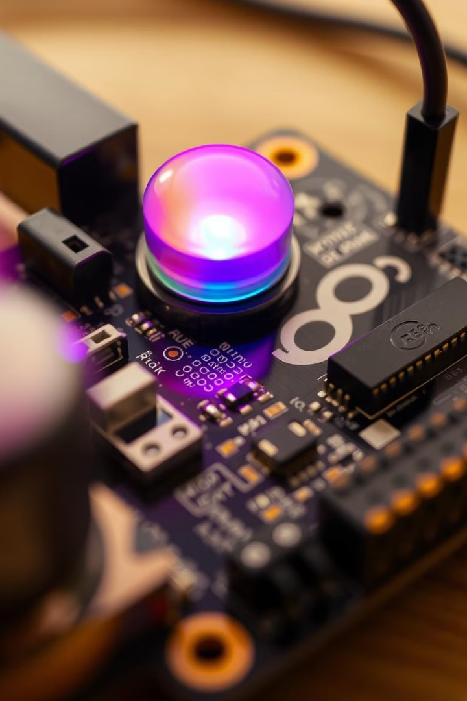



Controlling the LED
Mapping Values
Map the joystick's X-axis value to the LED's brightness.
Analog Write
Use the analogWrite() function to control the LED's brightness based on the mapped value.
Visual Feedback
The LED will brighten as you push the joystick to the right and dim as you push it to the left.

Slide 7



Triggering the Buzzer
Frequency Mapping
1
Map the joystick's Y-axis value to the buzzer's frequency.
Tone Function
2
Use the tone() function to generate sound at the mapped frequency.
Sound Output
3
The buzzer will produce a higher-pitched sound as you push the joystick up and a lower-pitched sound as you push it down.

Slide 8
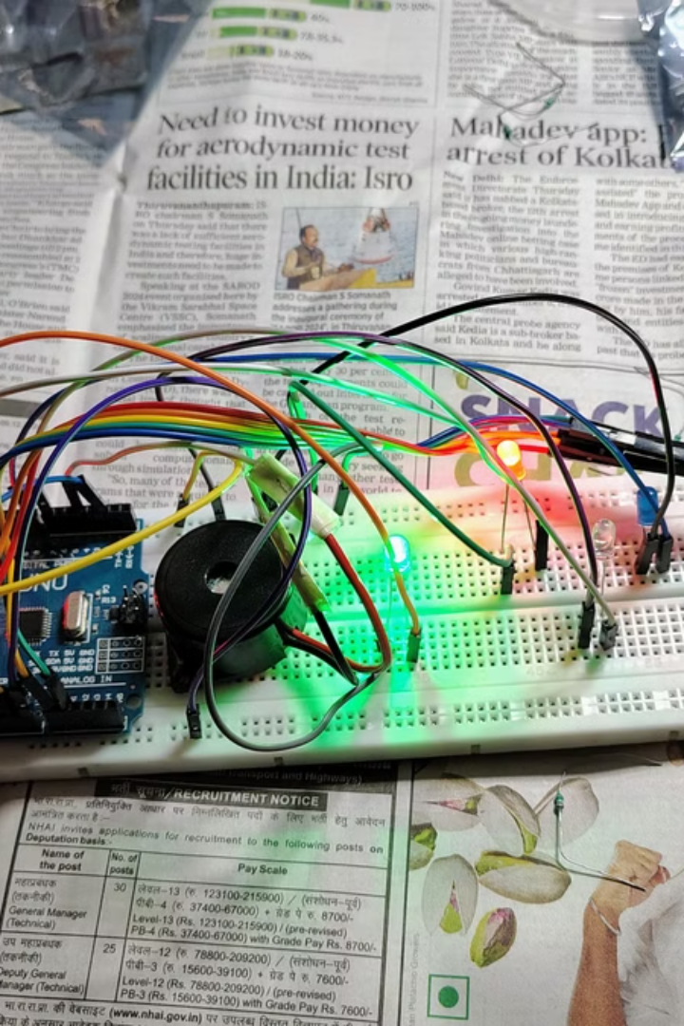
Project Demo and Next Steps
Witness the magic of your creation as the LED illuminates and the buzzer beeps in response to the joystick's movement.

